Slide 1
Skill Development/Guided Practice
You are going to plan an investigation to test whether the angle of sunlight affects the surface temperature on Earth.
You will use black paper stuck to a piece of cardboard to simulate the surface of the Earth.
One cardboard will be laid flat under the heat source, and another cardboard will be propped up on textbooks so it is at an angle.
You will measure the temperature of each piece of cardboard every minute for 15 minutes.

Slide 2
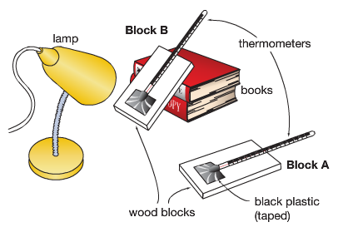
Timeline
You will have:
1 lesson to plan your investigation
title, aim, hypothesis, variables, materials, method
1 lesson to conduct the experiment
data table
1 lesson to write up
graph and interpreting and evaluating
This report will be assessed for inclusion in your 2020 report.

Slide 3
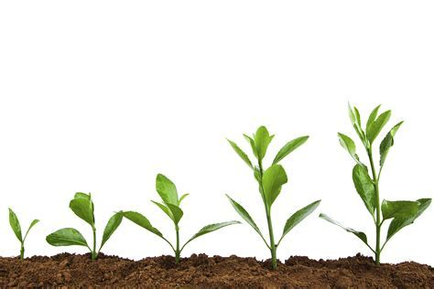
Skill Development/Guided Practice
Writing your title
Your title should be appropriate to the investigation, includes variables and is specific.
On your whiteboards, write a title for this investigation.
e.g The effect of potting mix on plant growth

Slide 4
Skill Development/Guided Practice
Writing your aim
An aim is a statement of what are you trying to find out in the investigation.
Write your aim in the form: “To find out if . . . . affects …..”
On your whiteboards, write an aim for this investigation.
e.g To find out if potting mix affects plant growth

Slide 5
Skill Development/Guided Practice
Difference between effect and affect
Effect is a noun
It refers to the outcome or end result of a change/experiment
It is used when writing titles
Affect is a verb
It means to impact or change
It is used in the aim

Slide 6
Skill Development/Guided Practice
Writing your hypothesis
A hypothesis is a testable statement of what you believe will be the outcome of the experiment.
Do not use the words “I predict” or “I think”.
Do not write it in the form of “this will happen” as this becomes a prediction, not a hypothesis.
On your whiteboards, write a hypothesis for this experiment.
e.g Potting mix increases plant growth.
Or Potting mix decreases plant growth.

Slide 7
Skill Development/Guided Practice
Identifying the variables
You need to think about how to make your investigation a fair test.
Identify the variables in your investigation:
Independent variable (what you are changing)
Dependent variable (what you are measuring/observing)
Controlled variables (what you need to keep the same) – at least 3
e.g
Independent variable: Soil type
Dependent variable: Amount of plant growth
Controlled variables: Amount of sunlight, type of plant, amount of water

Slide 8
Skill Development/Guided Practice
List of Equipment
Make a list of all the equipment you will need to use in your investigation.
Method
Write a method by which you can change one variable and measure its affect on the other.
Be specific with the steps in your method. It’s similar to writing a recipe.
Do not refer to a person/people in your method.
You may need to revise it before you write the report.
Results
Construct a table so that you can record the changes in the variables.

